Slide 1


Project
Sustainability
Analyser
Team Voxia
Introducing an innovative tool, powered by watsonx.ai, to analyze and enhance the sustainability of project ideas.

Slide 2
Problem Statement
Often, the lack of judgement in making decisions even in your day-to-day life could lead to hazardous impacts. Do not believe me?
Environmental Concerns
Inefficient Planning
Limited Perspective
"Are the carbon footprints looked over?"
Project designers often struggle to incorporate sustainable practices efficiently, resulting in increased workload and time consumption.
Is that 'eco-friendly' product truly sustainable? It's hard to tell without in-depth research.

Slide 3



Slide 4
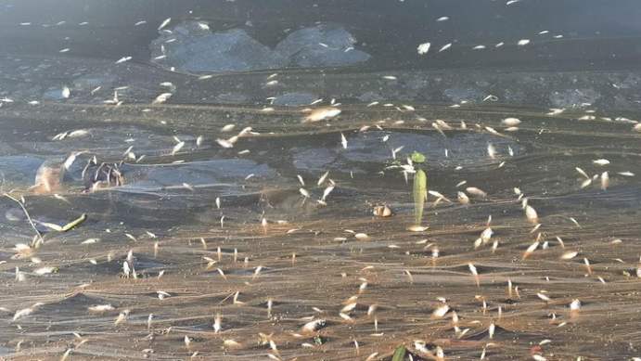
Fishes dead in Periyar River : high content of ammonia, hydrogen sulfide and other toxins.

Slide 5
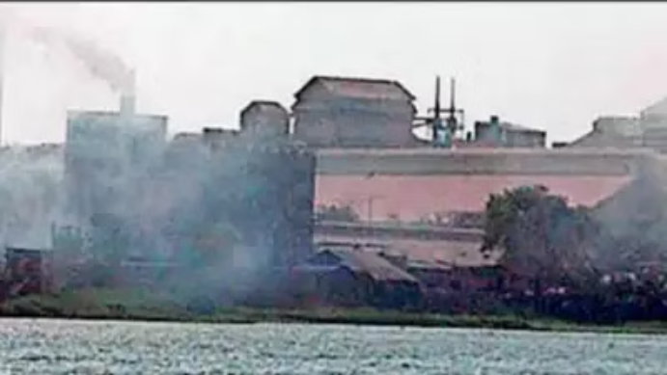
The Polluted Eloor-Edayar Belt : IQAir reports PM2.5 levels of 29.5µg/m3 to 35µg/m3, which is 5 to 7 times greater than safer levels in Eloor and Vyttila.

Slide 6
Our Solution
1
Watsonx AI Analysis
2
Sustainable Project Development
3
Fresh Perspective
Use watsonx AI to analyze project ideas for environmental sustainability and provide improvement suggestions.
Helps to get a different perspective of the project and give summarized ideas and materials.
Helps make project ideas more sustainable and reduce the workload of project designers.

Slide 7
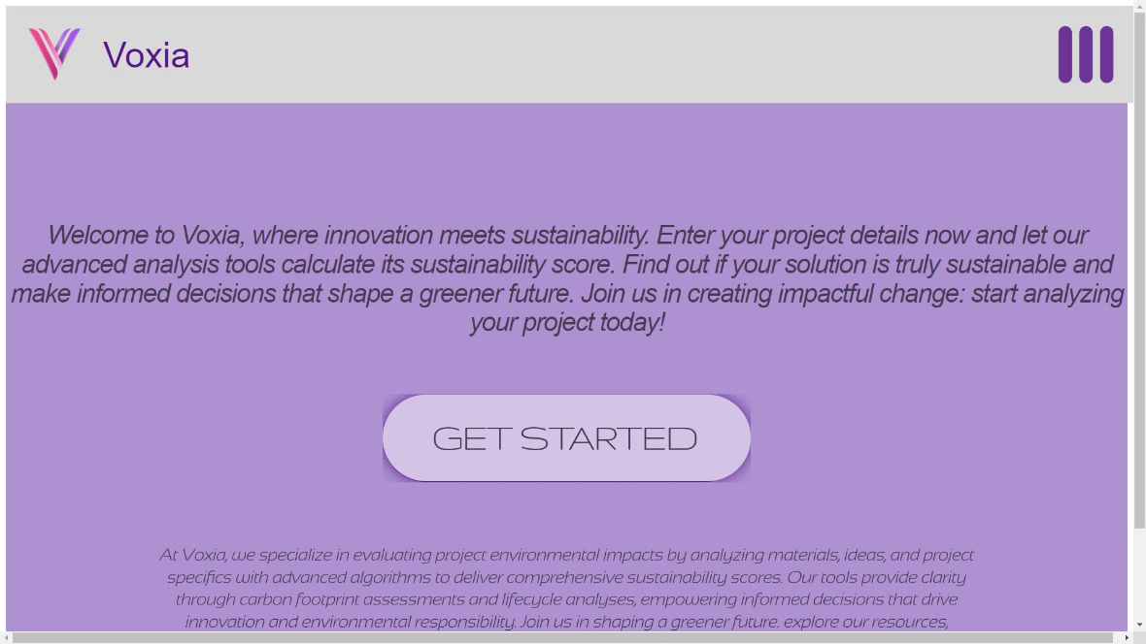
Our Product
https://67c816b4-b4d2-4ed1-962f-3164fb0c81b8-00-1g3cshb7konom.spock.replit.dev:5000/

Slide 8

Our Product

Slide 9
Analysing Materials Used
Sustainability Rating
Alternative Materials
Material Choice Update
Give sustainability rating based on the materials the project uses.
Give better material alternatives and justify the usage of recommended alternatives.
Redefine and update the material choice to be used for improved sustainability.

Slide 10




Why Should You Use Voxia?
Environmental Responsibility
Competitive Advantage
Protect the future of our nation and work for a cleaner world.
Using better practices in your product to give you an upper hand in the market.
Simplified Sustainability Assessment
Uses IBM's watsonx AI
Assessing the Environment Footprint you project might exhaust.
For better adaptation, scalability and tailoring to individual user's need.

Slide 11
Scalability
1
Industry-Specific Tuning
2
Problem-Focused Adaptation
3
Complexity Scaling
Can be fine tuned to specific Industries with help of input data from industry specialists.
Can be scaled up to recognize and suggest alternatives for more complicated projects.
Can be made to focus on a specific problem and trained with data for specific company or production.

Slide 12


Slide 13




Our Team
Swathi Dinesh
Richard B Melath
Aaquib Hanan
Neil Joseph
Team Lead
Member
Member
Member

